Slide 1
Introduction to AI
and how can it benefit our company
Notes:
Hello, welcome to my presentation of Introduction to AI. In this presentation, I will introduce you what is AI and most importantly, how can our company benefit from AI.

Slide 2
Agenda

Slide 3
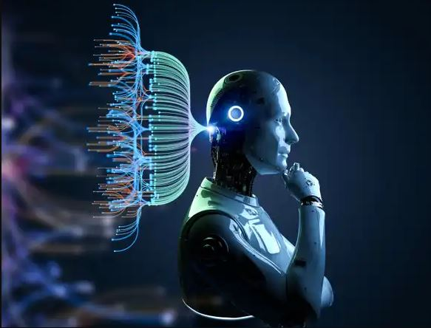
Artificial Intelligence
Definition: A logic-based technique to perform tasks that normally require human intelligence
Biggest fields are Traditional Machine Learning and Deep Learning
Source: https://seekingalpha.com/article/4593012-the-softer-side-of-artificial-intelligence
Notes:
So, first of all, what is Artificial Intelligence? Artificial Intelligence is a logic-based technique to perform tasks that normally require human intelligence. Such as predicting, decision making, recognizing, and so on.
And when we talk about AI, we cannot avoid talking about machine learning and deep learning, which I will address in the following slides.
As I was searching for the perfect image for this slide, I stumbled upon this one and immediately knew it was the one. It perfectly illustrates the secrets behind a successful AI - complex networks and vast amounts of data, all working together to make a final decision. It's a reminder that behind every powerful AI application, there is a complex and intricate system at work.

Slide 4
Traditional Machine Learning
Subfield of AI
Algorithms such as linear regression, k-nearest neighbors, and so on
Machine Learning does not use Neural Networks
In general faster, computationally lightweight, but can only deal with simpler tasks

Slide 5
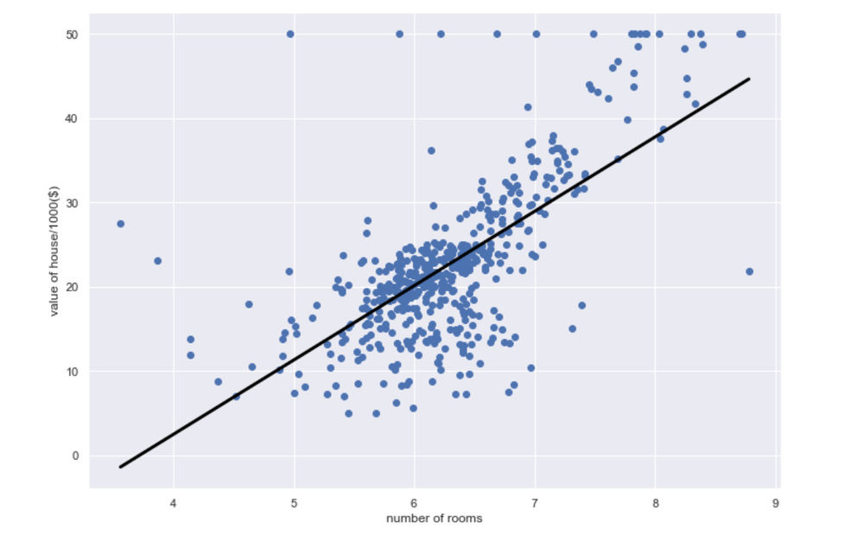
Traditional Machine Learning
Linear regression
Look for a line that fits the dataset the best
Makes prediction according to the line
House price prediction
Source: https://www.codersarts.com/post/predict-boston-house-prices-using-python-linear-regression

Slide 6
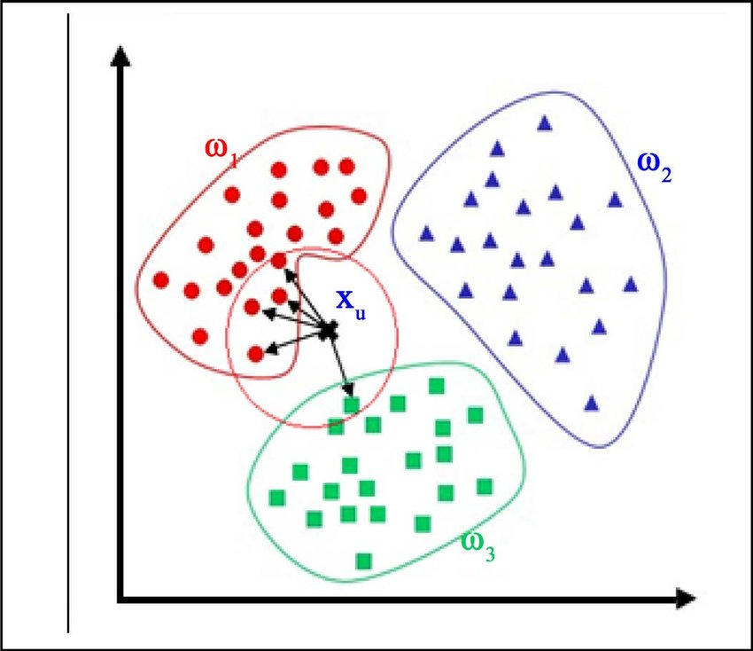
Traditional Machine Learning
K-nearest neighbor (k=5 in this case)
Different colors represent different classes of data points in the dataset
New data point is classified according to the count of nearest neighbors
Source: https://www.researchgate.net/figure/An-illustration-of-K-nearest-neighbor-model_fig6_321751429
Notes:
Example recommendation system

Slide 7
Deep Learning
A type of machine learning that involves the use of Neural Networks
In general computationally intensive but could deal with more difficult problems such as pattern recognition and speech recognition
Often requires a large amount of labeled data to train the model efficiently
Can achieve higher levels of accuracy than traditional machine learning models

Slide 8
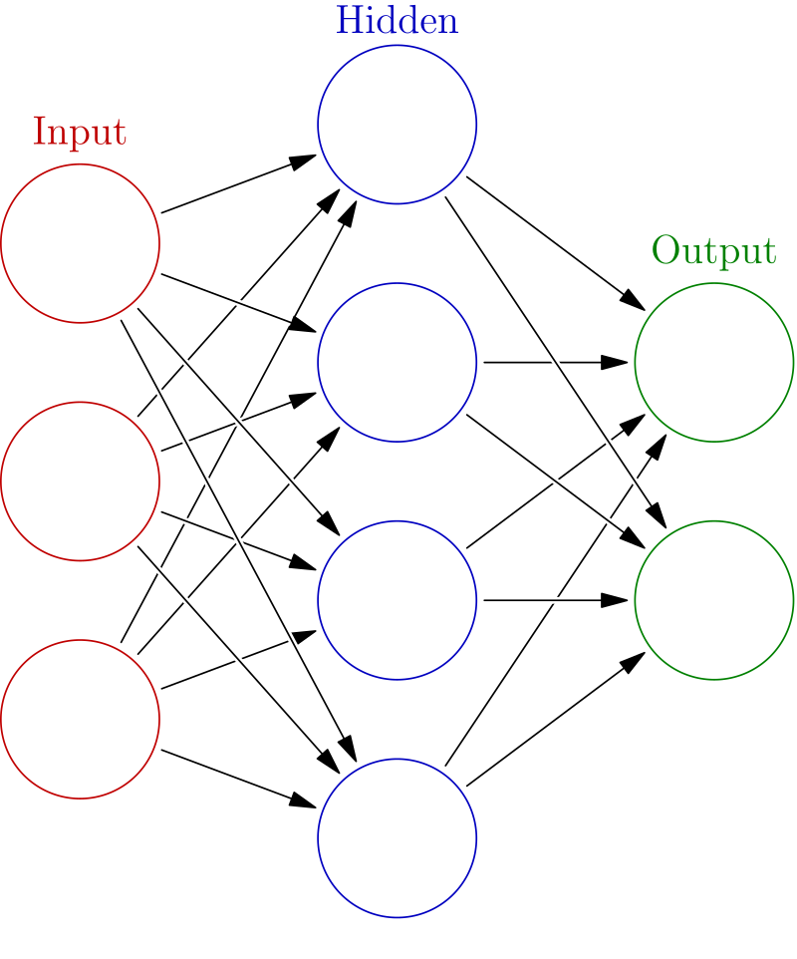
Deep Learning
Neural Network
Input, Hidden, and Output layer
Input layer takes Input, Hidden layer does some calculation, output received in Output layer
Notes:
Here we have a simplified neural network with just one hidden layer. However, achieving optimal training accuracy requires a much deeper network with multiple hidden layers. For example, the popular object detection model YOLO, which I have used in my past project, has around 53 hidden layers, while ChatGPT, which is based on the GPT-3.5 architecture, has 96 layers in total. Neural networks are designed to mimic the functioning of the human brain in learning and decision-making.

Slide 9
Deep Learning
Forward Propagation
Forward Propagation
Error is the difference Between the predicted outcome and the actual outcome
Backward Propagation
Gradient Descent to adjust the weights
This is one epoch
Do as many epochs until optimized result
w
w
w
w
w
w
w
w
w
Backward Propagation
Notes:
In a neural network, forward propagation refers to the process of moving input data through the layers of the network to generate an output prediction. During this process, the model calculates the difference between the predicted outcome and the actual outcome, which is known as the error.
Once the error is calculated, backward propagation comes into play. This involves using gradient descent to adjust the weights of the neural network in order to minimize the error and improve the accuracy of the predictions. This process is repeated for each training example in a dataset, and when this process is performed once for the entire dataset, it is known as one epoch.
The goal is to perform as many epochs as necessary to optimize the neural network's performance and achieve the desired level of accuracy. With this understanding of forward and backward propagation, we can now move forward in exploring how these processes are applied in various machine learning models.
Trash in trash out

